Slide 1

Weekly
PIT Meeting
EU UDAAN — AI Learning Pathways
July 14, 2026
naamii.org
1

Slide 2


Agenda
01 | AI Native Course Update
02 | Community Management Overview
03 | Project Updates
04 | General Roadmap
naamii.org
2

Slide 3
Active Action Items Status
Key actions and progress for the reporting week
# | Action Item | Owner | Status | Short Update/ Remarks
1 | Outreach Materials Distribution | @pradip |  | Needs review
2 | Onboarding AI native trainers (Institution) | @lhakpa |  | Needs review for shortlisted candidates​
3 | Project Management Board Setup (Internal & IMS) | @unisa |  | Workstream structure needs review
4 | Partnership SOP and outreach materials | @pradip |  | Joint pathsala concept note outline created; Ai school concept note in review
5 | AI Native cohort planning; course preparation | @drabid |  | Partners prospects mapped for July cohorts; course framework created
6 | Communication channel setup | @pradip |  | Research Complet​ed -> Structure being drafted.
In Review
In Progress
In Progress
In Progress
In Progress
In Progress
naamii.org
4

Slide 4

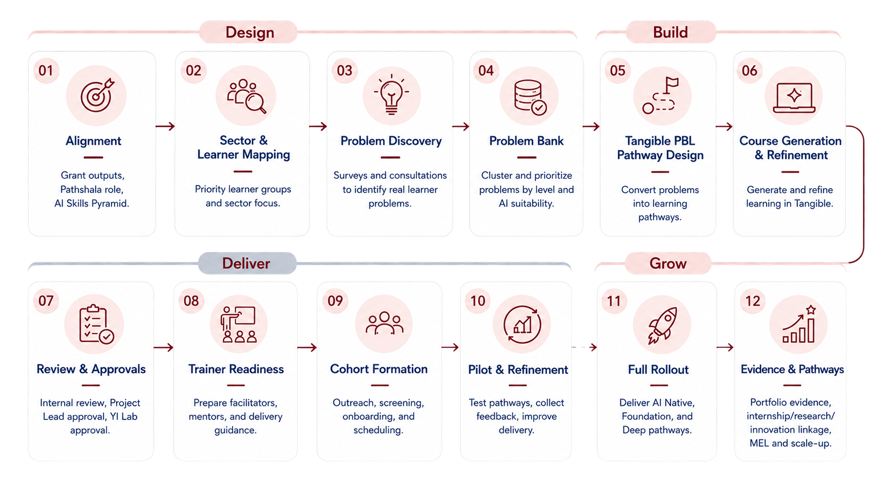
Project Roadmap
6
Notes:
Sector
Who belongs here
Examples
Main purpose in UDAAN
Education
Colleges, universities, campuses, academic institutions that directly help reach students
TU-affiliated colleges, private colleges, community colleges, universities, management/IT/social science colleges
Student mobilization, cohort delivery, faculty coordination, venue/lab support
Municipality
Local government bodies at city, municipality, rural municipality, or ward level
Metropolitan cities, municipalities, rural municipalities, ward offices
Local youth outreach, community mobilization, local rollout, civic innovation linkage
Science & Engineering
Technical, STEM, research, engineering, and innovation-focused institutions
Engineering colleges, technical institutes, research labs, robotics clubs, STEM associations, innovation labs
Technical mentors, applied AI problems, deep skill support, hackathon/project support
Government Organizations
Formal public institutions at national or provincial level, excluding municipalities
Ministries, departments, provincial ministries, government training centers, national boards, authorities
Institutional endorsement, policy alignment, public-sector pathways, scale support
Small Enterprises & Businesses
Local businesses, SMEs, cooperatives, startups, and business networks
SMEs, cooperatives, local enterprises, chambers, startup groups, women-led businesses
Real-world business problems, entrepreneurship exposure, local AI adoption
Fintech
Banking, digital finance, insurance, payment, and financial technology partners
Banks, digital wallets, microfinance institutions, insurance companies, fintech startups
Digital economy exposure, finance-related AI use cases, industry mentorship
Policy Makers / MPs
Individuals or groups influencing policy, legislation, or public discourse
MPs, policy advisors, parliamentary committees, think tanks, policy associations
Policy dialogue, advocacy, visibility, system-level influence
Hospitality
Tourism, hotel, travel, food service, and service-sector partners
Hotels, restaurants, travel companies, tourism associations, hospitality training institutes
Service-sector AI use cases, employment exposure, customer-service innovation
Health
Healthcare, public health, hospitals, clinics, health-tech, and medical institutions
Hospitals, clinics, health NGOs, public health bodies, med-tech/health-tech groups
Health AI use cases, applied problem statements, public health innovation

Slide 5
AI Native Cohort Targets
Weekly target plan | Aug 2026 – Dec 2026
2026 Goal
Delivery Window
Reqd Weekly Run Rate
Avg Monthly Target
2,000
22
~91
400
Learners
Weeks
Learners/ Week
Learners/ Month
AUG 2026
OCT 2026
NOV 2026
DEC 2026
AUG 2026
AUG 2026
SEP 2026
Monthly Target
Monthly Target
Monthly Target
Monthly Target
Monthly Target
455
364
364
363
454
W1 (Aug 3)
91
W6 (Sep 7)
91
W10 (Oct 5)
91
W14 (Nov 2)
91
W18 (Nov 30)
91
W2
91
W7
91
W11
91
W15
91
W19
91
W3
91
W8
91
W12
91
W16
91
W20
91
W4
91
W9 (Oct 4)
91
W13 (Nov 1)
91
W17 (Nov 29)
91
W21
91
W5 (Sep 6)
91
W22 (Dec 31)
91
23%
41%
59%
77%
100%
End Aug 2026:
End Sep 2026:
End Oct 2026:
End Nov 2026:
End Dec 2026:
naamii.org
455
819
1,183
1,546
2,000
5

Slide 6
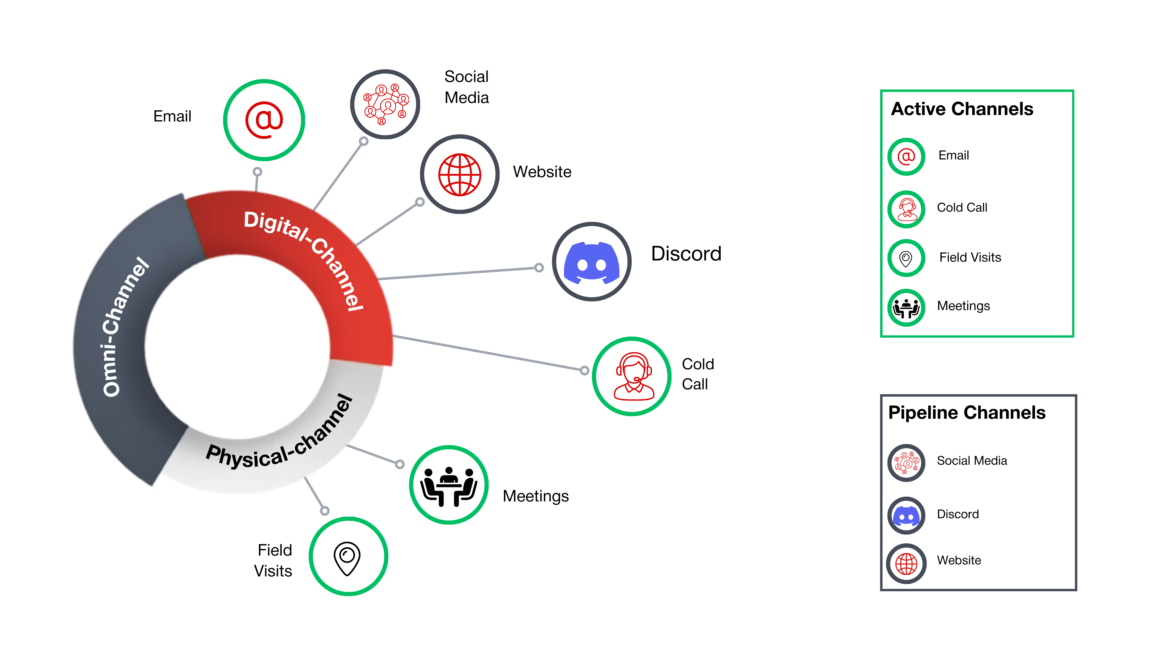
Communication Channel
naamii.org
7

Slide 7
Community Channel Structure
Proposed communication flow
Who Uses Which Channel
Learners
Announcements, learning support, cohort discussion
Announcement Channel
Learning Support
Cohort Discussion
Trainer Coordination
Trainers
Official updates, schedules, deadline
Peer interaction, activities, community building
Session support, facilitation, escalation
Learning support, mentor coordination
Course Q&A,
Resources, clarifications
Community Manager
Moderation, updates, engagement flow
naamii.org
5

Slide 8
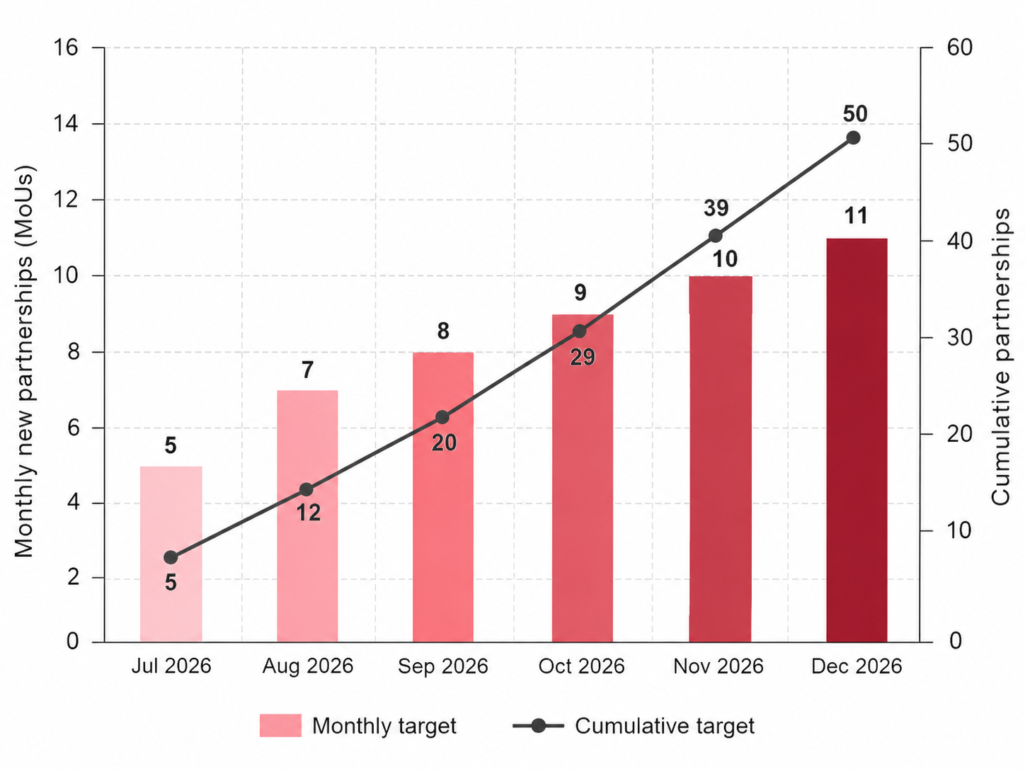
Partnership Targets - 2026
Monthly target plan | Aug 2026 – Dec 2026
Partnership Sectors (MoU-%)
2026 Partnership Goal
Education
  (20 -40%)
Science & engineering
  (4- 8%)
Municipality
  (13- 26%)
Govt orgs
  (2- 4%)
Small enterprises and businesses
  (4- 8%)
Fintech
  (1- 2%)
Policy makers/ MPs
  (1- 2%)
Hospitality
  (3- 6%)
Health
  (2- 4%)
50+
Across 9 sectors
Proposed Approach:
Step 1: Stakeholder Map
Step 2: Cold Reach
Step 3: Concept Note
Step 4: Focal Briefing
Step 5: Survey
Step 6: Cohort Preparation
Step 7: Cohort Delivery
Outreach Kickoff July onwards aiming 2-3 pilot cohorts starting July 3rd week
Step 8: Cohort Reporting
6
Notes:
Sector
Who belongs here
Examples
Main purpose in UDAAN
Education
Colleges, universities, campuses, academic institutions that directly help reach students
TU-affiliated colleges, private colleges, community colleges, universities, management/IT/social science colleges
Student mobilization, cohort delivery, faculty coordination, venue/lab support
Municipality
Local government bodies at city, municipality, rural municipality, or ward level
Metropolitan cities, municipalities, rural municipalities, ward offices
Local youth outreach, community mobilization, local rollout, civic innovation linkage
Science & Engineering
Technical, STEM, research, engineering, and innovation-focused institutions
Engineering colleges, technical institutes, research labs, robotics clubs, STEM associations, innovation labs
Technical mentors, applied AI problems, deep skill support, hackathon/project support
Government Organizations
Formal public institutions at national or provincial level, excluding municipalities
Ministries, departments, provincial ministries, government training centers, national boards, authorities
Institutional endorsement, policy alignment, public-sector pathways, scale support
Small Enterprises & Businesses
Local businesses, SMEs, cooperatives, startups, and business networks
SMEs, cooperatives, local enterprises, chambers, startup groups, women-led businesses
Real-world business problems, entrepreneurship exposure, local AI adoption
Fintech
Banking, digital finance, insurance, payment, and financial technology partners
Banks, digital wallets, microfinance institutions, insurance companies, fintech startups
Digital economy exposure, finance-related AI use cases, industry mentorship
Policy Makers / MPs
Individuals or groups influencing policy, legislation, or public discourse
MPs, policy advisors, parliamentary committees, think tanks, policy associations
Policy dialogue, advocacy, visibility, system-level influence
Hospitality
Tourism, hotel, travel, food service, and service-sector partners
Hotels, restaurants, travel companies, tourism associations, hospitality training institutes
Service-sector AI use cases, employment exposure, customer-service innovation
Health
Healthcare, public health, hospitals, clinics, health-tech, and medical institutions
Hospitals, clinics, health NGOs, public health bodies, med-tech/health-tech groups
Health AI use cases, applied problem statements, public health innovation

Slide 9
Upcoming Action Items
Key actions and progress for the reporting week
# | Action Item | Owner | Status | Short Update/ Remarks
1 | AI Native course finalization for college | @alok @bishesh |  | Demo-ready version of course structure, modules, learner journey, and expected outputs
2 | Community channel POC setup | @pradip @unisa |  | Confirmed channel list, purpose of each channel, and user groups
3 | MOUs and Focal point briefing for upcoming July AI native cohorts​ | @pradip |  | Briefing materials preparation.
4 | Communication channel setup and testing | @pradip @unisa |  | Finalize communication channel and SOP
5 | Municipality cohort planning for august with heifer | @pradip @unisa |  | Aligning timeline with Heifer fellowship
6 | PRs planning​ | @pradip @unisa |  | Utilizing public and social medias for program announcement
To be started
To be started
To be started
To be started
To be started
To be started
8

Slide 10
THANK YOU.
CONTACT US
E-mail
info@naamii.org.np
Linkedin
np.linkedin.com/company/naamiinepal
Website
naamii.org
Address
Jwagal, Lalitpur
naamii.org
10

